Slide 1

Coffee Shop Management System App
Parth Gangurde - 23107043 suhurd Ghanvatkar - 24107012 Harish Kodam - 24107055 Manthan Kangane - 24107075
Project Guide
Dr.Avinash Shrivas

Slide 2
Contents
Introduction
Objectives
Scope
Features / Functionality
Project Outcomes
Technology Stack
Block Diagram if applicable

Slide 3
1. Introduction
Problem Identified:
Coffee shops often manage orders and billing manually, which can cause errors and slow service.
Tracking menu items and daily sales without a digital system is difficult.
Solution Proposed:
Develop a Coffee Shop Management Mobile App to manage menu, orders, and billing digitally.
The app helps staff and customers handle orders quickly and efficiently.

Slide 4
2. Objectives
To improve order accuracy and track inventory usage.
To simplify menu and order management in the coffee shop
To automate billing and order processing.
To generate daily sales reports for better business tracking

Slide 5
3. Scope
Can be applied in coffee shops and small cafes to manage daily operations.
Can be useful for shop owners, staff, and customers for efficient order management.
Helps in reducing manual work and billing errors.
Can be extended in the future to include online payments .

Slide 6
4. Feature /Functionality
Feature 1: User Login / Auhentication
Users such as admin, staff, and customers can securely log in to the application. Authentication ensures that only authorized users can access specific features of the system.
Feature 2: Menu Management
Admin can add, update, or remove coffee items and other menu products. Customers can easily view the menu and available items in the app.
Feature 3: Order Management
Customers can place orders through the app, and staff can manage and update the order status. This helps in organizing and processing orders efficiently.

Slide 7
Feature 4: Billing System
The system automatically generates bills based on the items ordered. This reduces manual calculations and ensures accurate billing.
Feature 5: Daily Sales Report
Admin can view daily sales reports to track the total number of orders and revenue generated in the coffee shop.

Slide 8
5. Outcome of Project
User can register and log in to the application.
Customer can view coffee menu items available in the shop.
Customer can place orders through the mobile app.
Staff can manage and update customer orders.
System can generate bills automatically.
Admin can view daily sales reports and track shop performance.

Slide 9
6. Technology Stack
Frontend (GUI):
Flutter (Dart)
Backend:
Firebase
Database:
NOSQL

Slide 10
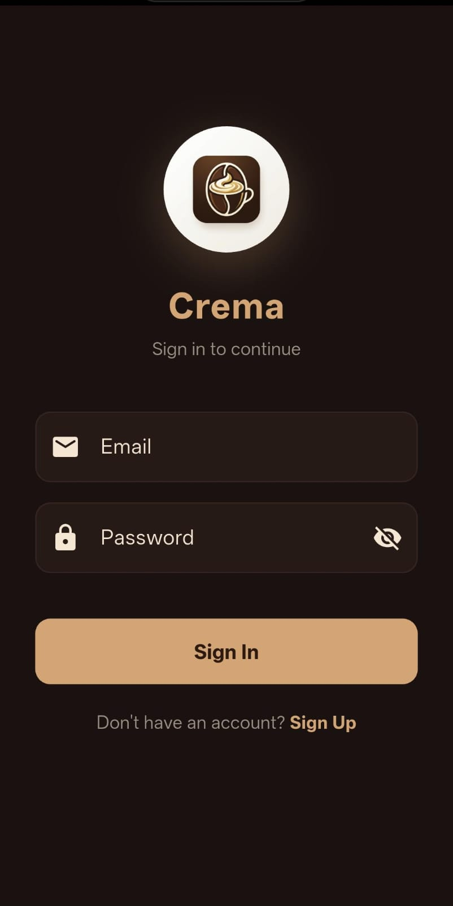
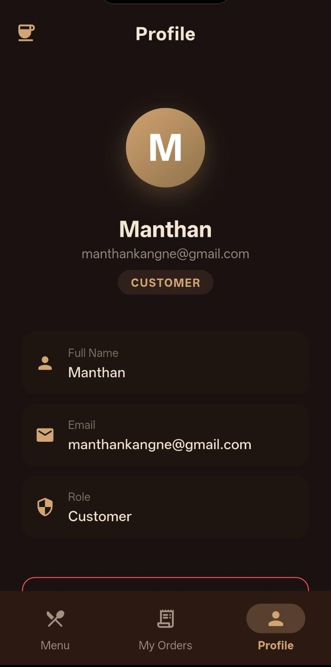
UI MOCKUPS:

Slide 11
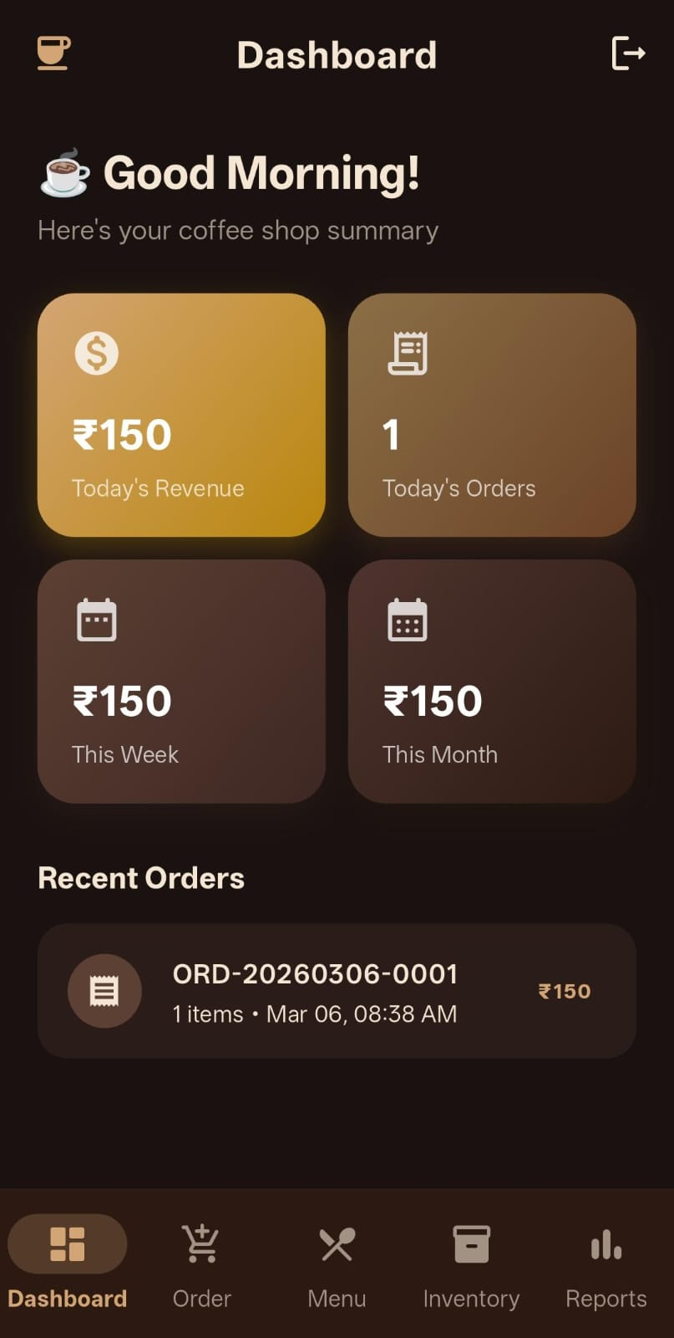
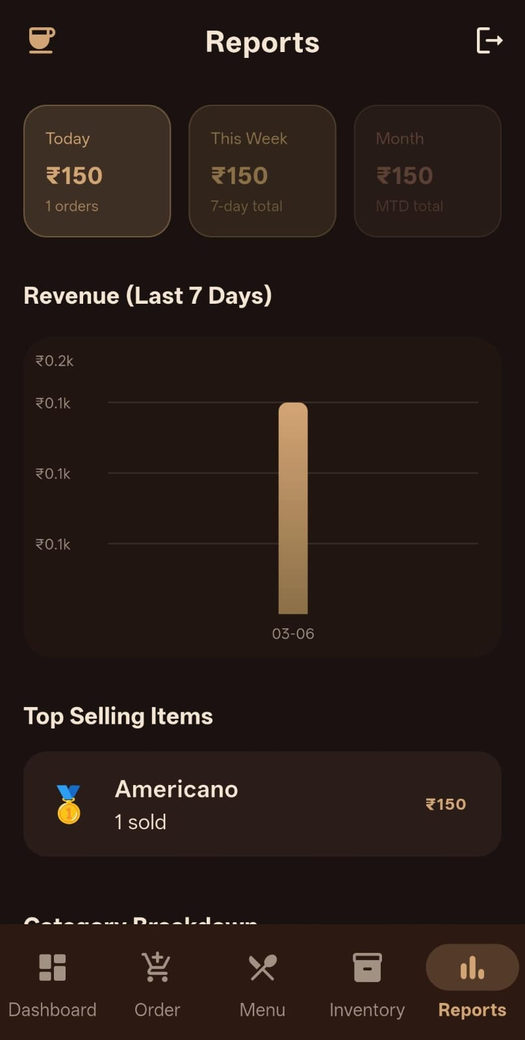
UI MOCKUPS:

Slide 12
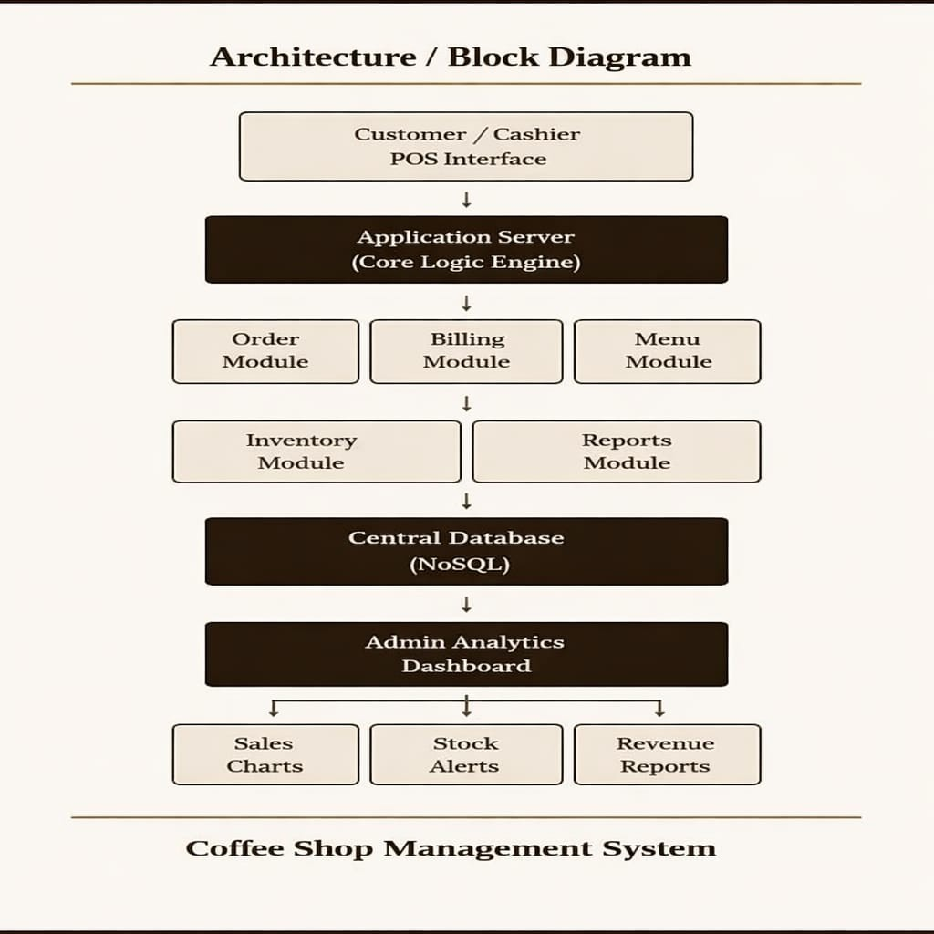
BLOCK DIAGRAM:

Slide 13
SDGs Mapped: SDG 2 – Zero Hunger Relevance: Use ethically sourced coffee beans from farmers. Support fair trade practices to ensure farmers earn fair wages. Example Actions: Partner with certified suppliers (Fairtrade coffee). Reduce food waste by donating unsold food.

Slide 14
SDG 8 – Decent Work and Economic Growth Relevance: Coffee shops create jobs and support local economies. Example Actions: Provide fair wages and safe working conditions. Offer skill training for baristas. Promote local hiring.

Slide 15
SDG 12 – Responsible Consumption and Production Relevance: High use of disposable cups and packaging. Example Actions: Use biodegradable or reusable cups. Minimize plastic use. Track and reduce food waste.

Slide 16
Thank You...!!

